Slide 1

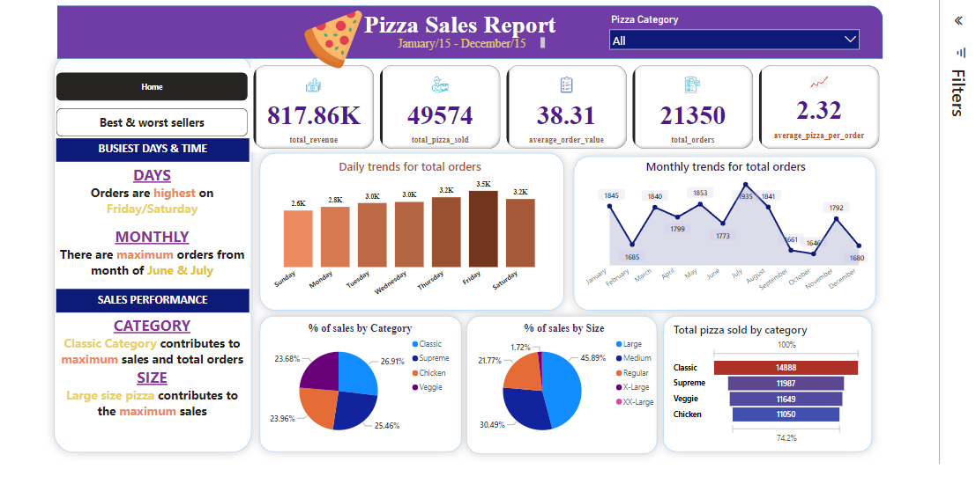
PIZZA Sales live embedded Dashboard using Power Bi

